Slide 1
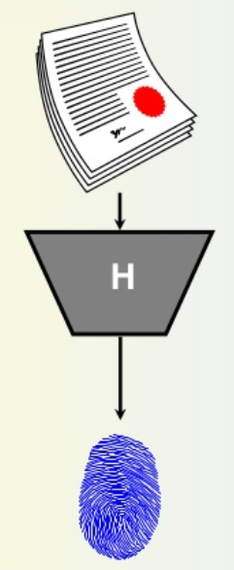
Cryptographic Hash and MAC

Slide 2
Outline
To introduce general ideas behind cryptographic hash functions
To discuss the Merkle-Damgard scheme as the basis for iterated hash functions
To distinguish between two categories of hash
functions.
To discuss the structure of SHA-512.

Slide 3
Outline
❏ To define message integrity
❏ To define message authentication
❏ To define criteria for a cryptographic hash function
❏ To define the Random Oracle Model and its role in
evaluating the security of cryptographic hash
functions
❏ To distinguish between an MDC and a MAC
❏ To discuss some common MACs

Slide 4
Message Authentication Requirements
Disclosure
2. Traffic analysis
3. Masquerade
4. Content modification
5. Sequence modification
6. Timing modification
7. Source repudiation
8. Destination repudiation

Slide 5
Message Authentication Functions
Hash function: A function that maps a message of any length into a fixed length hash value, which serves as the authenticator
Message encryption: The ciphertext of the entire message serves as its authenticator
Message authentication code (MAC): A function of the message and a secret key that produces a fixed-length value that serves as the authenticator

Slide 6
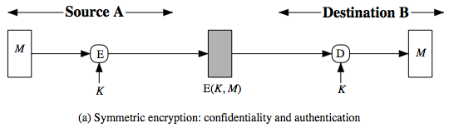
Symmetric Message Encryption
encryption can also provides authentication
if symmetric encryption is used then:
  receiver know sender must have created it
  since only sender and receiver now key used
  know content cannot have been altered
  if message has suitable structure, redundancy or a checksum to detect any changes
Notes:
Message encryption by itself can provide a measure of authentication. The analysis differs for symmetric and public-key encryption schemes.
If use symmetric encryption, If no other party knows the key, then confidentiality is provided. As well, symmetric encryption provides authentication as well as confidentiality, since only the other party can have encrypted a properly constructed message (Stallings Figure 12.1a). Here, the ciphertext of the entire message serves as its authenticator, on the basis that only those who know the appropriate keys could have validly encrypted the message. This is provided you can recognize a valid message (ie if the message has suitable structure such as redundancy or a checksum to detect any changes).

Slide 7
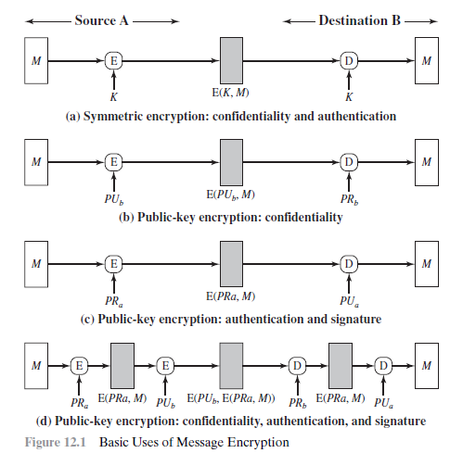
Message Encryption
Notes:
Message encryption by itself can provide a measure of authentication. The analysis differs for symmetric and public-key encryption schemes.
If use symmetric encryption, If no other party knows the key, then confidentiality is provided. As well, symmetric encryption provides authentication as well as confidentiality, since only the other party can have encrypted a properly constructed message (Stallings Figure 12.1a). Here, the ciphertext of the entire message serves as its authenticator, on the basis that only those who know the appropriate keys could have validly encrypted the message. This is provided you can recognize a valid message (ie if the message has suitable structure such as redundancy or a checksum to detect any changes).

Slide 8
Message Integrity
The cryptography systems that we have studied so far provide secrecy, or confidentiality, but not integrity. However, there are occasions where we may not even need secrecy but instead must have integrity.
Topics:
1 Document and Fingerprint
2 Message and Message Digest
3 Difference
4 Checking Integrity
5 Cryptographic Hash Function Criteria

Slide 9
Document and Fingerprint
One way to preserve the integrity of a document is through the use of a fingerprint. If Alice needs to be sure that the contents of her document will not be changed, she can put her fingerprint at the bottom of the document.

Slide 10
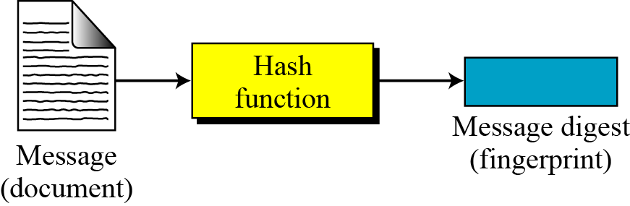
Message and Message Digest
The electronic equivalent of the document and fingerprint pair is the message and digest pair.
A hash function H accepts a variable-length block of data M as input and produces
a fixed-size hash value h = H(M).
Figure Message and digest

Slide 11
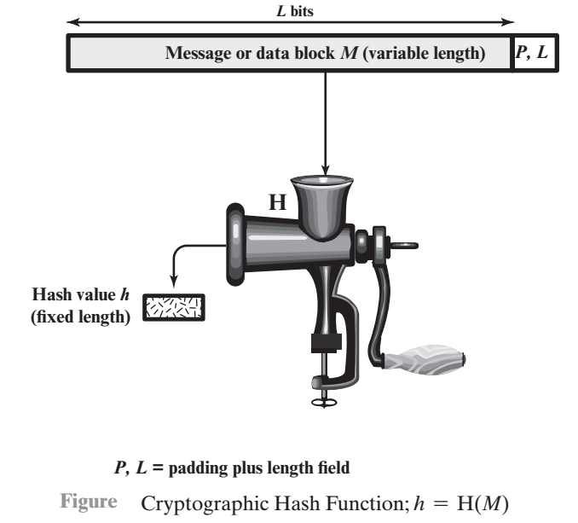
Cryptographic Hash Function

Slide 12
Application of Cryptographic Hash Function
Message Authentication: Message authentication is a mecha-nism or service used to verify the integrity of a message.
When a hash function is used to provide message authentication,
the hash function value is often referred to as a message digest.

Slide 13
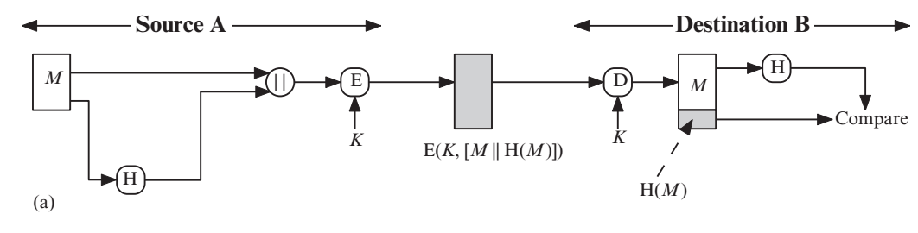
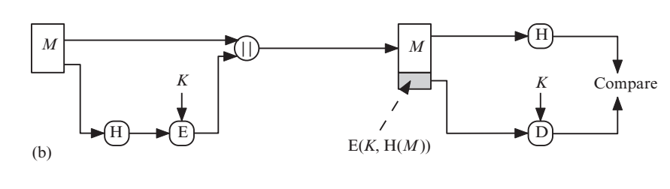
Application of Cryptographic Hash Function
Figures illustrates a variety of ways in which a hash code can be used to provide message authentication, as follows.

Slide 14
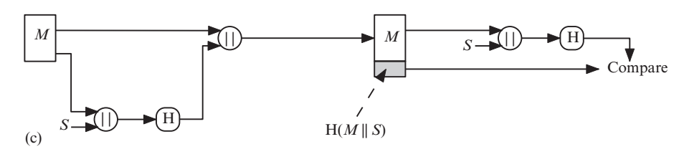
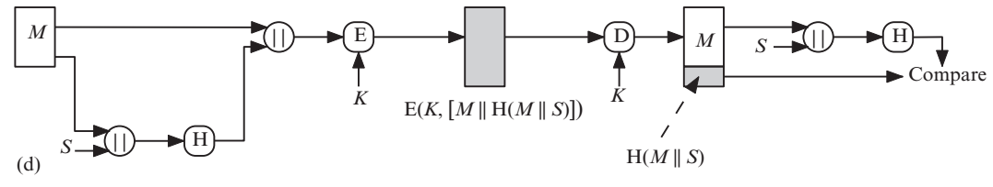
Application of Cryptographic Hash Function

Slide 15
MAC
More commonly, message authentication is achieved using a message authentication code (MAC), also known as a keyed hash function. Typically, MACs are used between two parties that share a secret key to authenticate information exchanged between those parties.

Slide 16
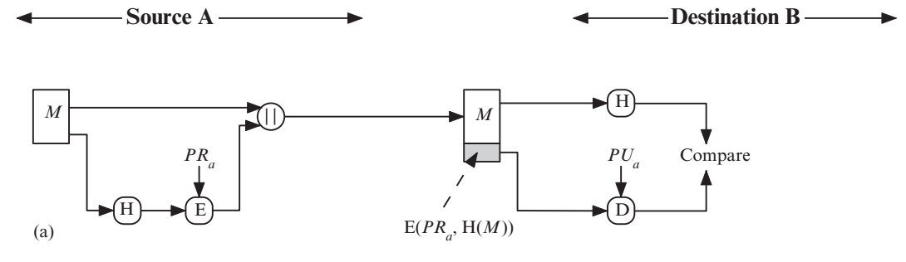
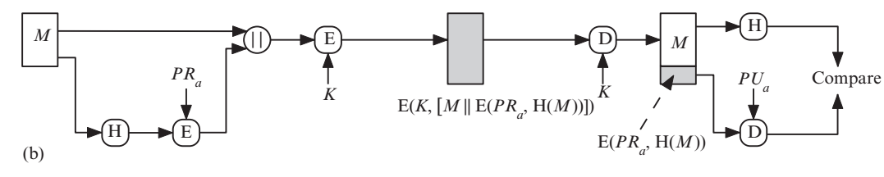
Digital Signatures
A digital signature is achieved throw:

Slide 17
Other Applications
One way password file:
Hash functions can be used for intrusion detection and virus detection.
can be used to construct a pseudorandom function (PRF) or a pseudorandom number generator (PRNG).

Slide 18
Difference
The two pairs (document / fingerprint) and (message / message digest) are similar, with some differences. The document and fingerprint are physically linked together. The message and message digest can be unlinked separately, and, most importantly, the message digest needs to be safe from change.
The message digest needs to be safe from change.

Slide 19
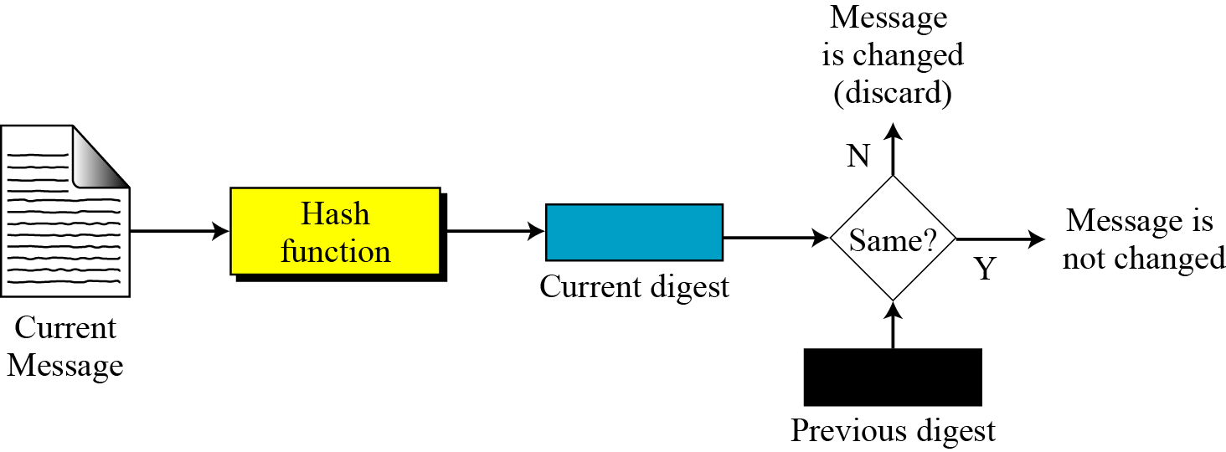
Checking Integrity
Figure Checking integrity

Slide 20
Cryptographic Hash Function
Variable-size input: Accepts a block of data of any arbitrary length.
Fixed-size output: Produces a hash value (digest) of a fixed length.
Efficiency: Easy to compute H(x) for any given message x in both hardware and software.
Pseudorandomness: Output demonstrates high entropy and satisfies statistical randomness properties
Pre-image Resistance (One-Way Property): For any given hash value h, it is computationally infeasible to find x such that H(x) = h.
Second Pre-image Resistance (Weak Collision Resistance): For any given input x, it is computationally infeasible to find y ≠ x such that H(y) = H(x).
Collision Resistance (Strong Collision Resistance): It is computationally infeasible to find any pair of distinct inputs (x, y) such that x ≠ y and H(x) = H(y)

Slide 21
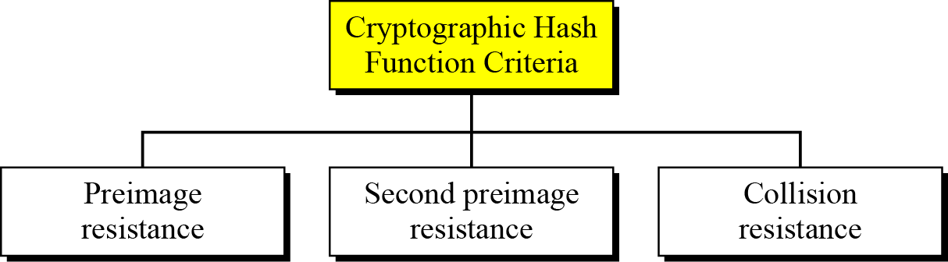
Cryptographic Hash Function Criteria
A cryptographic hash function must satisfy three criteria: preimage resistance, second preimage resistance, and collision resistance.
Figure Criteria of a cryptographic hash function

Slide 22
One Way Function: what is computationally infeasible?
Given y, find x such that h(x) = y
  An inverse problem
  If it is a cryptographic hash function with 128 bit digest, need to try about half of the messages to find a message that maps to y.
  Need to try about 2127 messages
  This should be computationally infeasible.

Slide 23
Second pre-image resistant - computational cost
Given x, find y ≠ x such that h(x) = h(y)
  Try messages to find some y that maps to the same value as x.
  For a 128 bit digest, the expected number of messages to try is again about 2127 messages for a 0.5 probability of success

Slide 24
Collision Resistant - computational cost
Find y, x, with y ≠ x such that h(x) = h(y)
  For a cryptographic hash function, this requires solving the birthday problem, which is about 2⁶⁴ messages for a 128 bit message digest
  Note that collision resistant
⇒ second pre-image resistant
  Use (A ⇒ B is the same as ¬B ⇒ ¬ A)

Slide 25
Constructing Hash Functions
Since constructing secure hash functions is a difficult problem, the following approach has been taken in practice:
– Construct a good compression function. Since the domain of compression functions are “small” they are easier to test for the desired properties.
Use the MD construction (next) to turn a one-way, collision-resistant compression function into a hash function with similar properties.

Slide 26
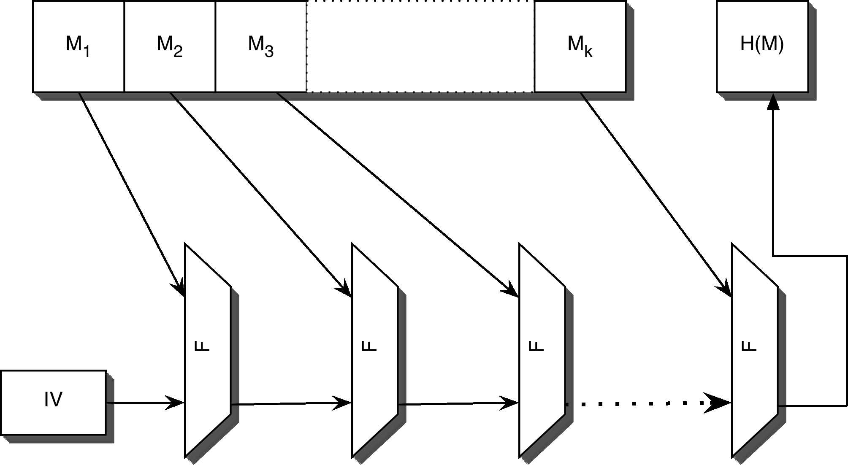
Merkle-Damgard (MD)

Slide 27
A Somewhat Different View
constant
padded message
one block
digest
one block
digest
one block
digest
msg digest

Slide 28
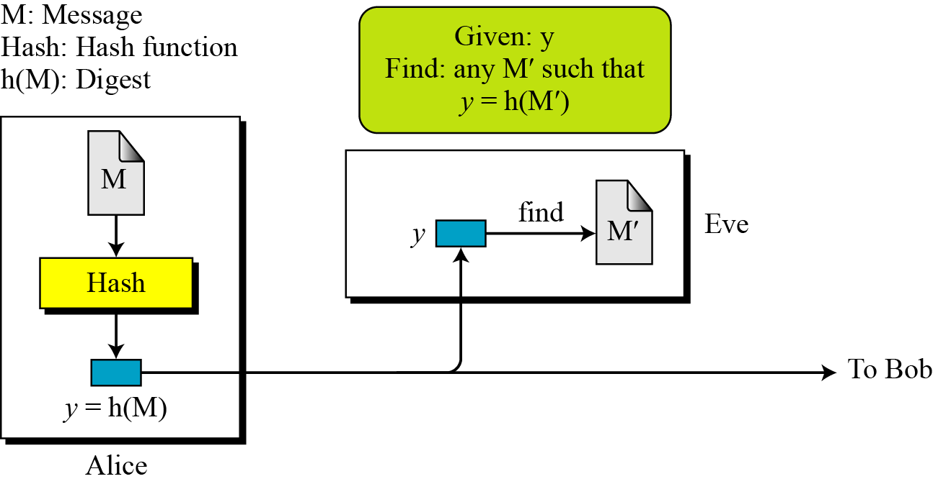
Preimage Resistance
Preimage Resistance
Figure Preimage

Slide 29
Preimage Resistance
Example
Can we use a conventional lossless compression method such as StuffIt as a cryptographic hash function?
Solution
We cannot. A lossless compression method creates a compressed message that is reversible.
Example
Can we use a checksum function as a cryptographic hash function?
Solution
We cannot. A checksum function is not preimage resistant, Eve may find several messages whose checksum matches the given one.

Slide 30
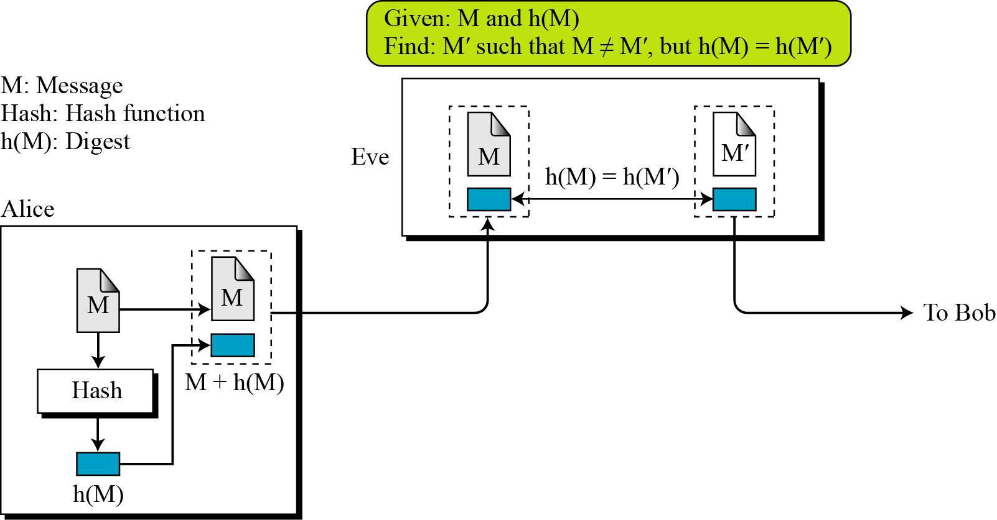
Second Preimage Resistance
Second Preimage Resistance
Figure Second preimage

Slide 31
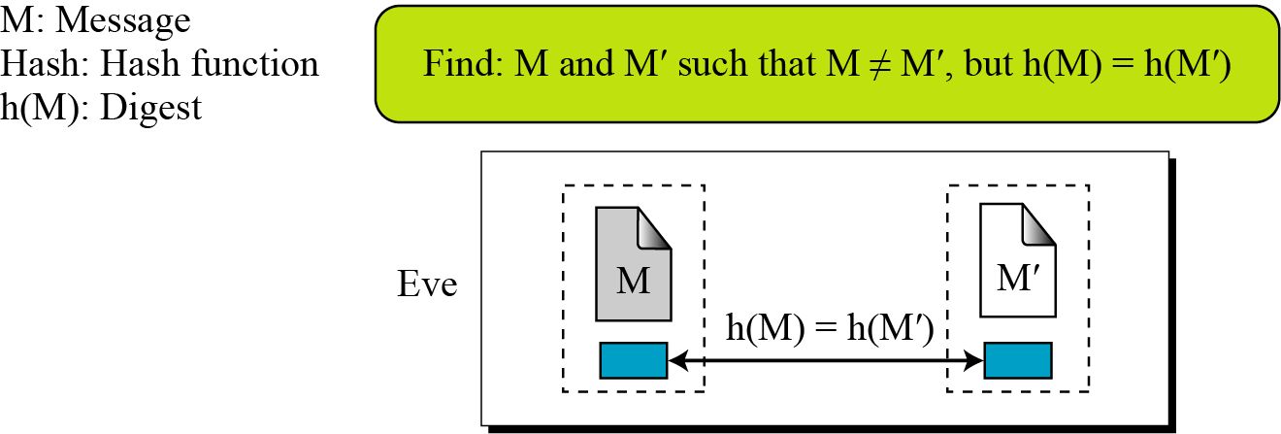
Collison Resistance
Collision Resistance
Figure Collision

Slide 32
Random Oracle Model
The Random Oracle Model, which was introduced in 1993 by Bellare and Rogaway, is an ideal mathematical model for a hash function.
Topics :
1 Pigeonhole Principle
2 Birthday Problems
3 Attacks on Random Oracle Model
4 Attacks on the Structure

Slide 33
Random Oracle Model
The Random Oracle Model, which was introduced in 1993 by Bellare and Rogaway, is an ideal mathematical model for a hash function.
Behaviour of Random Oracle Model:
For new message, creates random digest and stores both of them
If message is given, returns digest if exists
Digest for new message is independent from all previous digests

Slide 34
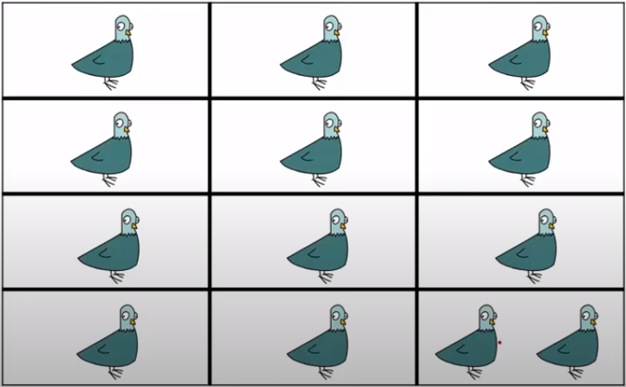
Pigeonhole Principal
If n pigeonholes are occupied by n + 1 pigeons, then at least one pigeonhole is occupied by two pigeons. The generalized version of the pigeonhole principle is that if n pigeonholes are occupied by kn + 1 pigeons, then at least one pigeonhole is occupied by k + 1 pigeons.
Behaviour of Random Oracle Model:
n=12

Slide 35
Pigeonhole Principal
Example
Assume that the messages in a hash function are 6 bits long and the digests are only 4 bits long. Then the possible number of digests (pigeonholes) is 24 = 16, and the possible number of messages (pigeons) is 26 = 64. This means n = 16 and kn + 1 = 64, so k is larger than 3. The conclusion is that at least one digest corresponds to four (i.e., k + 1) messages.

Slide 36
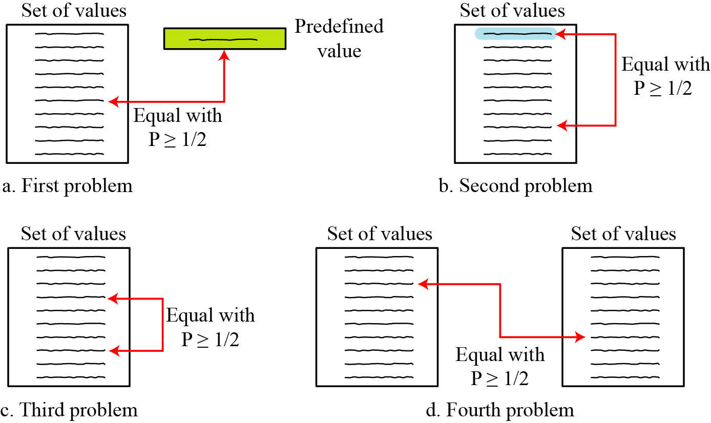
Birthday Problems
Figure Four birthday problems are usually encountered in Probability courses
Selected value
What Min number, k, list size
At least one matches
Any two values
any value
Birthday paradox
any value
Min number k values (same two sts)

Slide 37
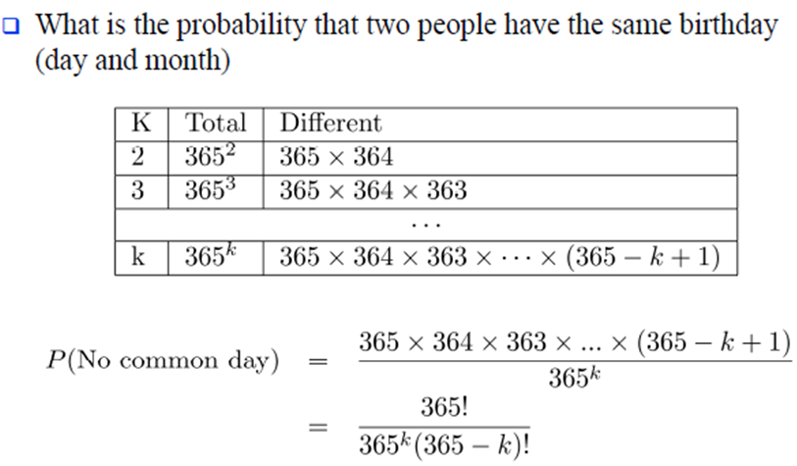
Birthday Problems

Slide 38
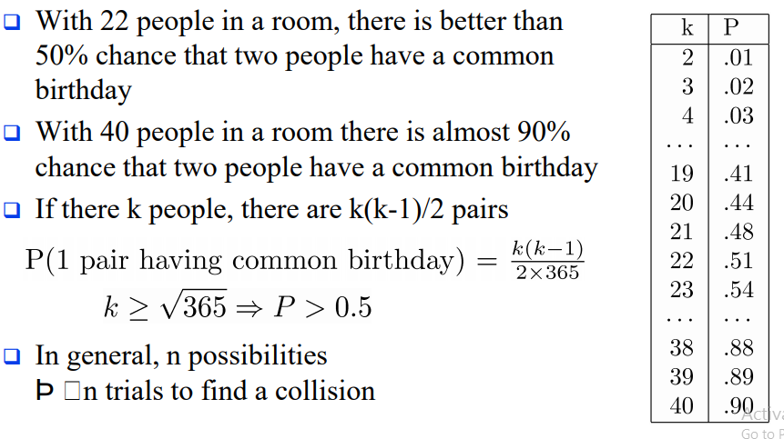


Birthday Problems

Slide 39
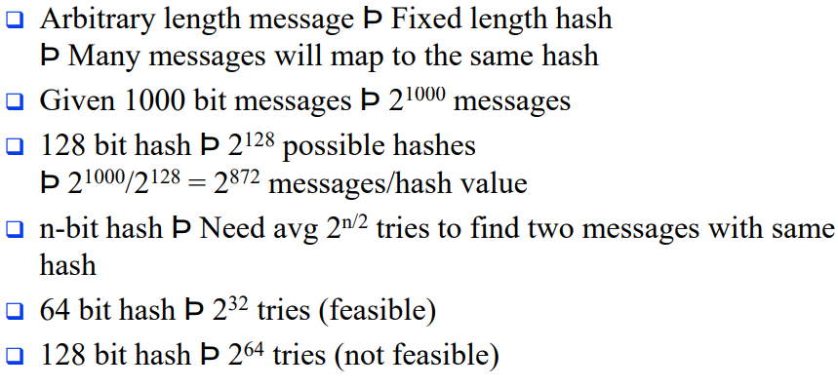

Birthday Problems

Slide 40
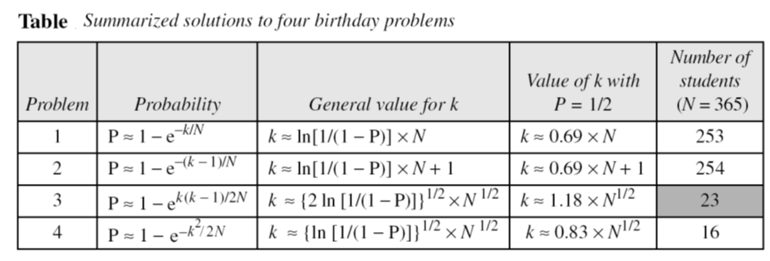
Birthday Problems
Summary of Solutions
Solutions to these problems are given in Appendix E for interested readers; The results are summarized in Table.

Slide 41
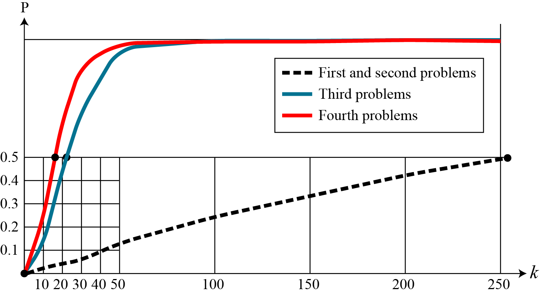
Comparison
Comparison
Figure Graph of four birthday problem
, probability
Preimage attack
Collision attack

Slide 42
Examples of Crypto Hash Functions
Comparison
MD4 = Message Digest 4 - 32b operations
MD5 = Message Digest 5 - 32b operations
SHA = Secure hash algorithm [NIST]
SHA-1 = Updated SHA
SHA-2 = SHA-224, SHA-256, SHA-384, SHA-512 SHA-512 uses 64-bit operations

Slide 43
Cryptographic hash function Types
A cryptographic hash function takes a message of arbitrary length and creates a message digest of fixed length. The ultimate goal in this lesson is to discuss the details of the two most promising cryptographic hash algorithms SHA-512 and Whirlpool.
1 Iterated Hash Function
2 Two Groups of Compression Functions

Slide 44
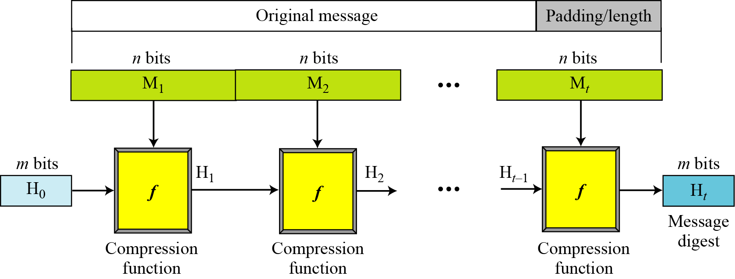
Iterated Hash Function
Merkle-Damgard Scheme : All cryptographic hash functions need to create a fixed-size digest out of a variable size message -> iteration
If compression function is collision resistant, the entire structure is collision resistant
Initial Vector
Notes:
Before proceeding, we should mention several common misconceptions concerning
public-key encryption. One such misconception is that public-key encryption
is more secure from cryptanalysis than is symmetric encryption. In fact, the
security of any encryption scheme depends on the length of the key and the computational
work involved in breaking a cipher. There is nothing in principle about
either symmetric or public-key encryption that makes one superior to another from
the point of view of resisting cryptanalysis.
A second misconception is that public-key encryption is a general-purpose
technique that has made symmetric encryption obsolete. On the contrary, because
of the computational overhead of current public-key encryption schemes, there
seems no foreseeable likelihood that symmetric encryption will be abandoned. As
one of the inventors of public-key encryption has put it [DIFF88], “the restriction
of public-key cryptography to key management and signature applications is almost
universally accepted.”
Finally, there is a feeling that key distribution is trivial when using public-key
encryption, compared to the rather cumbersome handshaking involved with
key distribution centers for symmetric encryption. In fact, some form of protocol
is needed, generally involving a central agent, and the procedures involved are not
simpler nor any more efficient than those required for symmetric encryption (e.g.,
see analysis in [NEED78]).

Slide 45
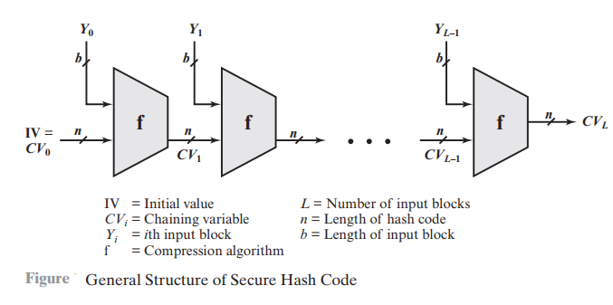
Iterated Hash Function
Notes:
Before proceeding, we should mention several common misconceptions concerning
public-key encryption. One such misconception is that public-key encryption
is more secure from cryptanalysis than is symmetric encryption. In fact, the
security of any encryption scheme depends on the length of the key and the computational
work involved in breaking a cipher. There is nothing in principle about
either symmetric or public-key encryption that makes one superior to another from
the point of view of resisting cryptanalysis.
A second misconception is that public-key encryption is a general-purpose
technique that has made symmetric encryption obsolete. On the contrary, because
of the computational overhead of current public-key encryption schemes, there
seems no foreseeable likelihood that symmetric encryption will be abandoned. As
one of the inventors of public-key encryption has put it [DIFF88], “the restriction
of public-key cryptography to key management and signature applications is almost
universally accepted.”
Finally, there is a feeling that key distribution is trivial when using public-key
encryption, compared to the rather cumbersome handshaking involved with
key distribution centers for symmetric encryption. In fact, some form of protocol
is needed, generally involving a central agent, and the procedures involved are not
simpler nor any more efficient than those required for symmetric encryption (e.g.,
see analysis in [NEED78]).

Slide 46
Two Groups of Compression Functions
1. The compression function is made from scratch.
Message Digest (MD) (by Ron Rivest), SHA (by NIST
2. A symmetric-key block cipher serves as a compression function.
Whirlpool
Notes:
Before proceeding, we should mention several common misconceptions concerning
public-key encryption. One such misconception is that public-key encryption
is more secure from cryptanalysis than is symmetric encryption. In fact, the
security of any encryption scheme depends on the length of the key and the computational
work involved in breaking a cipher. There is nothing in principle about
either symmetric or public-key encryption that makes one superior to another from
the point of view of resisting cryptanalysis.
A second misconception is that public-key encryption is a general-purpose
technique that has made symmetric encryption obsolete. On the contrary, because
of the computational overhead of current public-key encryption schemes, there
seems no foreseeable likelihood that symmetric encryption will be abandoned. As
one of the inventors of public-key encryption has put it [DIFF88], “the restriction
of public-key cryptography to key management and signature applications is almost
universally accepted.”
Finally, there is a feeling that key distribution is trivial when using public-key
encryption, compared to the rather cumbersome handshaking involved with
key distribution centers for symmetric encryption. In fact, some form of protocol
is needed, generally involving a central agent, and the procedures involved are not
simpler nor any more efficient than those required for symmetric encryption (e.g.,
see analysis in [NEED78]).

Slide 47
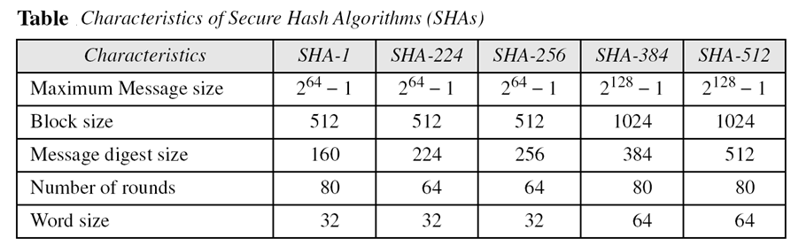
Secure Hash Function
Notes:
Before proceeding, we should mention several common misconceptions concerning
public-key encryption. One such misconception is that public-key encryption
is more secure from cryptanalysis than is symmetric encryption. In fact, the
security of any encryption scheme depends on the length of the key and the computational
work involved in breaking a cipher. There is nothing in principle about
either symmetric or public-key encryption that makes one superior to another from
the point of view of resisting cryptanalysis.
A second misconception is that public-key encryption is a general-purpose
technique that has made symmetric encryption obsolete. On the contrary, because
of the computational overhead of current public-key encryption schemes, there
seems no foreseeable likelihood that symmetric encryption will be abandoned. As
one of the inventors of public-key encryption has put it [DIFF88], “the restriction
of public-key cryptography to key management and signature applications is almost
universally accepted.”
Finally, there is a feeling that key distribution is trivial when using public-key
encryption, compared to the rather cumbersome handshaking involved with
key distribution centers for symmetric encryption. In fact, some form of protocol
is needed, generally involving a central agent, and the procedures involved are not
simpler nor any more efficient than those required for symmetric encryption (e.g.,
see analysis in [NEED78]).

Slide 48
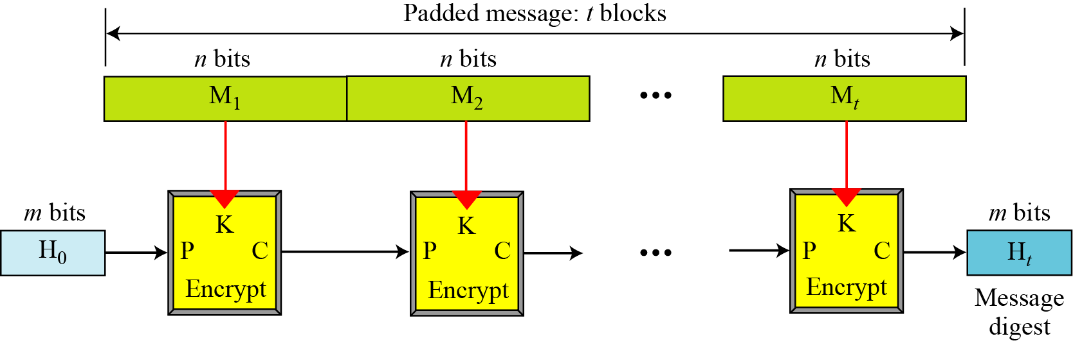
Hash Functions Based on Block Ciphers
Rabin Scheme (based on M-D scheme) uses any cipher as compression function
Figure Rabin scheme
vulnerable to meet-in-the-middle attack
Notes:
Before proceeding, we should mention several common misconceptions concerning
public-key encryption. One such misconception is that public-key encryption
is more secure from cryptanalysis than is symmetric encryption. In fact, the
security of any encryption scheme depends on the length of the key and the computational
work involved in breaking a cipher. There is nothing in principle about
either symmetric or public-key encryption that makes one superior to another from
the point of view of resisting cryptanalysis.
A second misconception is that public-key encryption is a general-purpose
technique that has made symmetric encryption obsolete. On the contrary, because
of the computational overhead of current public-key encryption schemes, there
seems no foreseeable likelihood that symmetric encryption will be abandoned. As
one of the inventors of public-key encryption has put it [DIFF88], “the restriction
of public-key cryptography to key management and signature applications is almost
universally accepted.”
Finally, there is a feeling that key distribution is trivial when using public-key
encryption, compared to the rather cumbersome handshaking involved with
key distribution centers for symmetric encryption. In fact, some form of protocol
is needed, generally involving a central agent, and the procedures involved are not
simpler nor any more efficient than those required for symmetric encryption (e.g.,
see analysis in [NEED78]).

Slide 49
Hash Functions Based on Block Ciphers
Rabin Scheme (based on M-D scheme) uses any cipher as compression function
Figure Rabin scheme
vulnerable to meet-in-the-middle attack
Notes:
Before proceeding, we should mention several common misconceptions concerning
public-key encryption. One such misconception is that public-key encryption
is more secure from cryptanalysis than is symmetric encryption. In fact, the
security of any encryption scheme depends on the length of the key and the computational
work involved in breaking a cipher. There is nothing in principle about
either symmetric or public-key encryption that makes one superior to another from
the point of view of resisting cryptanalysis.
A second misconception is that public-key encryption is a general-purpose
technique that has made symmetric encryption obsolete. On the contrary, because
of the computational overhead of current public-key encryption schemes, there
seems no foreseeable likelihood that symmetric encryption will be abandoned. As
one of the inventors of public-key encryption has put it [DIFF88], “the restriction
of public-key cryptography to key management and signature applications is almost
universally accepted.”
Finally, there is a feeling that key distribution is trivial when using public-key
encryption, compared to the rather cumbersome handshaking involved with
key distribution centers for symmetric encryption. In fact, some form of protocol
is needed, generally involving a central agent, and the procedures involved are not
simpler nor any more efficient than those required for symmetric encryption (e.g.,
see analysis in [NEED78]).

Slide 50
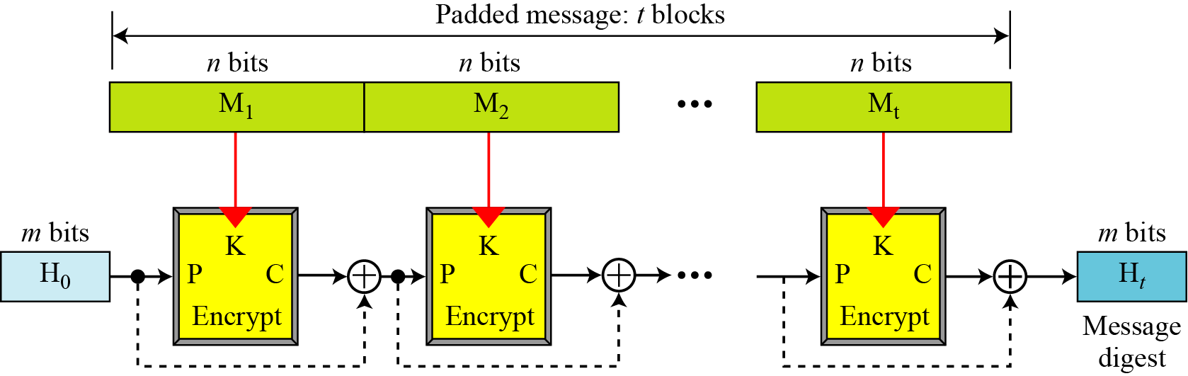
Hash Functions Based on Block Ciphers
Davies-Meyer Scheme
Figure Davies-Meyer scheme
To protect from meet-in-the-middle attack
Notes:
Before proceeding, we should mention several common misconceptions concerning
public-key encryption. One such misconception is that public-key encryption
is more secure from cryptanalysis than is symmetric encryption. In fact, the
security of any encryption scheme depends on the length of the key and the computational
work involved in breaking a cipher. There is nothing in principle about
either symmetric or public-key encryption that makes one superior to another from
the point of view of resisting cryptanalysis.
A second misconception is that public-key encryption is a general-purpose
technique that has made symmetric encryption obsolete. On the contrary, because
of the computational overhead of current public-key encryption schemes, there
seems no foreseeable likelihood that symmetric encryption will be abandoned. As
one of the inventors of public-key encryption has put it [DIFF88], “the restriction
of public-key cryptography to key management and signature applications is almost
universally accepted.”
Finally, there is a feeling that key distribution is trivial when using public-key
encryption, compared to the rather cumbersome handshaking involved with
key distribution centers for symmetric encryption. In fact, some form of protocol
is needed, generally involving a central agent, and the procedures involved are not
simpler nor any more efficient than those required for symmetric encryption (e.g.,
see analysis in [NEED78]).

Slide 51
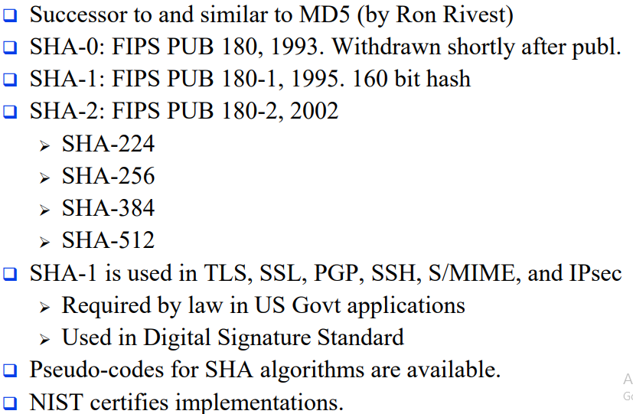
Secure Hash Algorithm

Slide 52
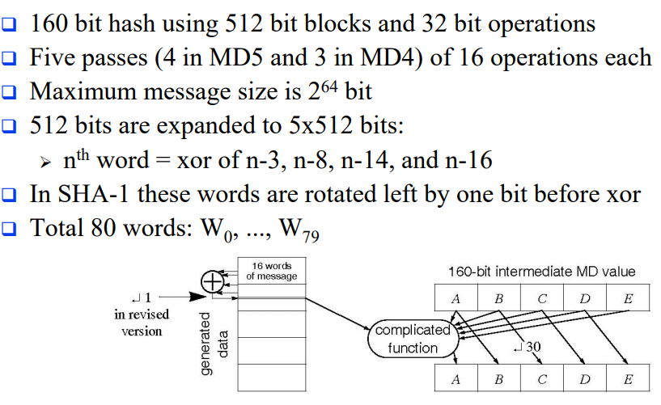
SHA-1
Wt = ( W[t-3]⊕W[t-8]⊕W[t-14]⊕W[t-16] ) <<< 1

Slide 53

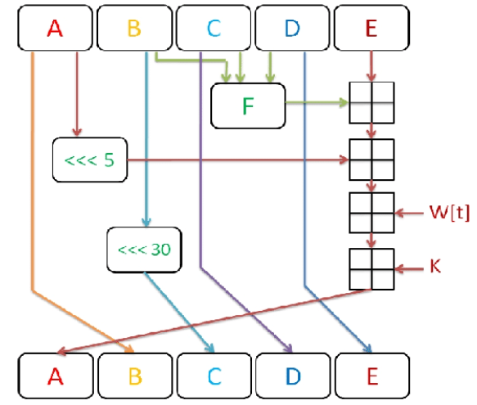
SHA-1
1. In the first step hash variables are initialized. let
k is round constants
2. The second step massage word W[0-15] extended into 80 word W[16-79]
16 ≤ t ≤ 79
W[t] = ( W[t-3]⊕W[t-8]⊕W[t-14]⊕W[t-16] ) <<< 1
3. In the third step 5 variable (A to E) is added which is equal to (H0 to H4)
4. The fourth step is the main loop which is (A to E) will be calculated in 80 Round as following:

Slide 54
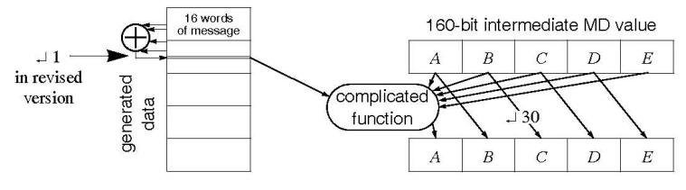
SHA-1

Slide 55
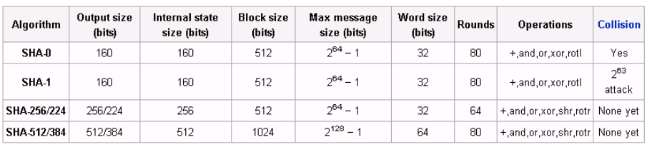
SHA-2
SHA-256 uses 32-bit operations
SHA-512 uses 64-bit operations
Use different shift amounts and additive constants
SHA-224 and SHA-384 are simply truncated versions of SHA256 and SHA-512 using different initial values.
SHA-224 matches the key length of two-key triple-DES

Slide 56
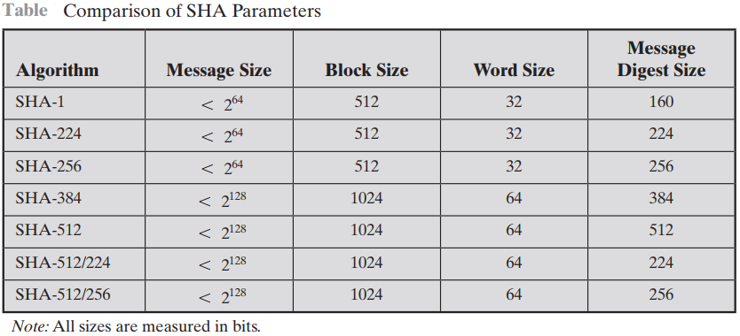
Secure Hash Algorithm

Slide 57
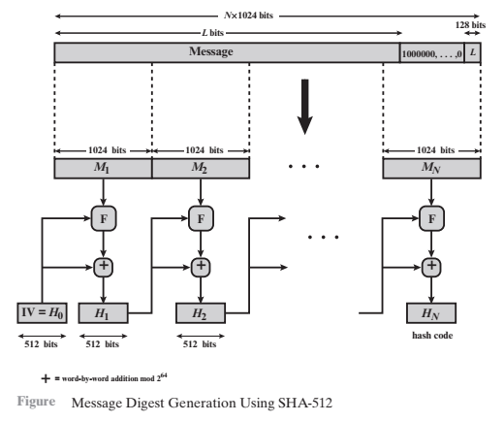
SHA-512

Slide 58
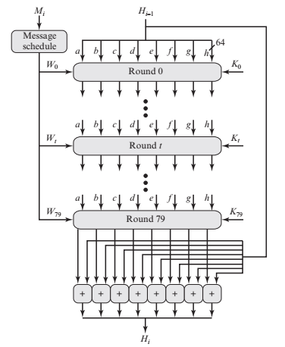
SHA-512
SHA-512 Processing of a Single 1024-Bit Block (single block)

Slide 59
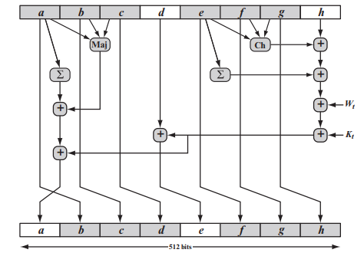
SHA-512 Round Function
Elementary SHA-512 Operation (single round)

Slide 60
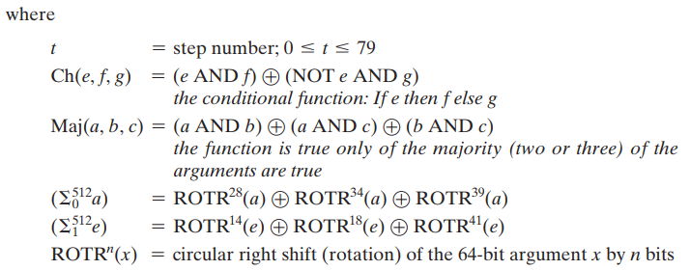
SHA-512
Elementary SHA-512 Operation (single round)

Slide 61
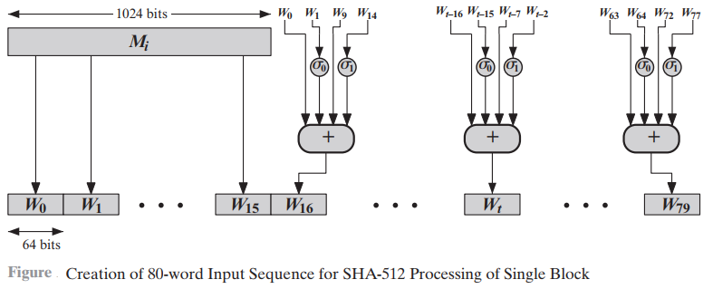
SHA-512: 80-Word Input Sequence
From 16 words (1024 bits) to 80 words

Slide 62
SHA-3
SHA-2 (esp. SHA-512) seems secure
Shares same structure and mathematical operations as predecessors so have concern
NIST announced in 2007 a competition for the SHA-3
Has had 3 rounds of narrowing down the selections
Five algorithms advanced to the third (and final) round in
December 2010
Final selection announced in 2012

Slide 63
SHA-3
❑ Replace SHA-2 with SHA-3 in any use
So use same hash sizes
❑ Preserve the online nature of SHA-2
So must process small blocks (512 / 1024 bits)
❑ Evaluation criteria
Security close to theoretical max for hash sizes
Cost in time & memory
Characteristics: such as flexibility & simplicity

Slide 64
Secret Key Cryptography: Insecure Channels and Media
Confidentiality
  Using a secret key cipher such as DES/CBC, we can assure that messages sent on a medium cannot be tapped by an eavesdropper
  Distribute a secret key between two parties, then use encryption on the sender’s side and decryption on the receiver’s side using any of the block or stream ciphers
  Can use the same technique for storing information on a disk: encrypt the information and decrypt when needed
  Check the tool GnuPG: http://www.gnupg.org/
Integrity?

Slide 65
Checksums and CRCs
Used to provide integrity checks against random faults.
Not sufficient for protection against malicious or
intentional modification.
  Easy to make changes and re-compute the CRC to match.
In the past, it was believed that the use of CRCs within encryption was sufficient to provide integrity. However, that is no longer considered adequate:
  Example: The use of CRCs in the WEP protocol resulted in a serious vulnerability, allowing for powerful active attacks.

Slide 66
Message Authentication Code (MAC)
A MAC is a cryptographic checksum that serves as an authenticator of the message
  Generate a fixed length MAC (say 128 bits) from an arbitrary message
  A “secret” key is used to generate the MAC
  MAC should not be invertible
The term message integrity code (MIC) is sometimes used and probably more accurate

Slide 67
Using MACs
K
Sender
Receiver
M, T
MAC
MAC
M
M
T
T’

Slide 68
MAC using Secret Key System
m₁ |  | m₂ |  | m₃ |  |  | m₄
⊕ E |  | ⊕ E |  | ⊕ E |  |  | ⊕ E
c₁ |  | c₂ |  | c₃ |  |  | c₄: CBC Residue
Interested in integrity; not confidentiality
Encrypt message; use last encrypted block as the MAC
Send message + CBC residue
m₁ || m₂ || m₃ || m₄ || c₄

Slide 69
Encryption + Integrity
False solution:
– Use a weak (non-cryptographic) checksum inside CBC: May
prove to be completely insecure!
Possible solutions
  Use two different keys in CBC mode (expensive).
  Use a different authentication mechanism, such as HMAC, which still requires processing the data twice, but less computationally costly.
  Use another encryption mode that provides both encryption and
authentication (the future?)
Some care must be taken when combining encryption with MACs, in general

Slide 70
Order of Encryption/Authentication
Encrypt then authenticate:
– E_{k’} (m) || MAC_{k’’}(E_{k’} (m))
Generally secure, independent of the mode of encryption used
Has the advantage to permit MAC verification before decryption (early compromise detection and avoidance of unnecessary cryptographic operations)

Slide 71
Authentication+Encryption
Authenticate then encrypt:
– E_{k’} (m, MAC_{k’’}(m))
Unsafe if a mode other than CBC is used.
Provably secure with CBC.
Does not permit verification before decryption.
Authentication tag can be pre-computed, and remains associated with the original message after decryption.

